Slide 1
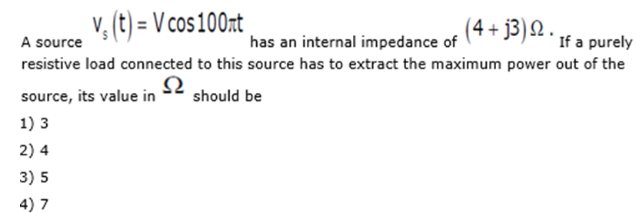
GATE 2013

Slide 2
Answer--3

Slide 3
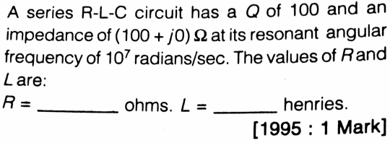
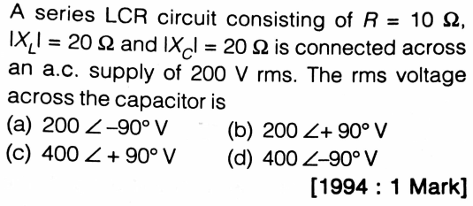
GATE

Slide 4
Answer1 R=100 Ohm L= 1 mH
Answer 3--d

Slide 5
A 9 mH coil is in parallel with a 0.015 μF capacitor across an 18 kHz ac source. The coil's internal resistance R_{W}, is 60 Ω. The circuit impedance is (A) 17,340 Ω
(B) 1,734 Ω
(C) 290 Ω
(D) 1,018 Ω

Slide 6
Answer: Option A

Slide 7
A resonant circuit has a lower critical frequency of 7 kHz and an upper critical frequency of 13 kHz. The bandwidth of the circuit is (A) 7 kHz
(B) 13 kHz
(C) 20 kHz
(D) 4 kHz

Slide 8
Answer: Option D

Slide 9
A 200 Ω resistor, a coil with 30 Ω of reactance, and a capacitor of unknown reactance are in series across an ac source. The circuit is at resonance. Circuit impedance is
(A) 230 Ω
(B) 170 Ω
(C) 200 Ω
(D) Cannot be determined

Slide 10
Answer: Option C

Slide 11
A resistor of 3 kΩ, a 0.05 μF capacitor, and a 120 mH coil are in series across a 5 kHz, 20 V ac source. What is the impedance, expressed in polar form? (A) 636 Ω
(B) 3,769 Ω
(C) 433 Ω
(D) 4,337 Ω

Slide 12
Answer: Option D

Slide 13
A transformer transforms
(a) voltage
(b) current
(c) power
(d) frequency

Slide 14
1. Which of the following does not change in a transformer ?
(a) Current
(b) Voltage
(c) Frequency
(d) All of the above

Slide 15
A transformer cannot raise or lower the voltage of a D.C. supply because
(a) there is no need to change the D.C. voltage
(b) a D.C. circuit has more losses
(c) Faraday's laws of electromagnetic induction are not valid since the rate of change of flux is zero
(d) none of the above

Slide 16
2. In a transformer the energy is conveyed from primary to secondary
(a) through cooling coil
(b) through air
(c) by the flux
(d) none of the above

Slide 17
3. A transformer core is laminated to
(a) reduce hysteresis loss
(b) reduce eddy current losses
(c) reduce copper losses
(d) reduce all above losses

Slide 18
4. The degree of mechanical vibrations produced by the laminations of a transformer depends on
(a) tightness of clamping
(b) gauge of laminations
(c) size of laminations
(d) all of the above

Slide 19
The path of a magnetic flux in a transformer should have
(a) high resistance
(b) high reluctance
(c) low resistance
(d) low reluctance

Slide 20
No-load on a transformer is carried out to determine
(a) copper loss
(b) magnetising current
(c) magnetising current and loss
(d) efficiency of the transformer

Slide 21
Sumpner's test is conducted on trans-formers to determine
(a) temperature
(b) stray losses
(c) all-day efficiency
(d) none of the above

Slide 22
The efficiency of a transformer will be maximum when
(a) copper losses = hysteresis losses
(b) hysteresis losses = eddy current losses
(c) eddy current losses = copper losses
(d) copper losses = iron losses

Slide 23
The purpose of providing an iron core in a transformer is to
(a) provide support to windings
(b) reduce hysteresis loss
(c) decrease the reluctance of the magnetic path
(d) reduce eddy current losses

Slide 24
Which of the following is not a part of transformer installation ?
(a) Conservator
(b) Breather
(c) Buchholz relay
(d) Exciter

Slide 25
While conducting short-circuit test on a transformer the following side is short circuited
(a) High voltage side
(b) Low voltage side
(c) Primary side
(d) Secondary side

Slide 26
he essential condition for parallel operation of two single-phase transformer is that they should have the same
KVA Rating
Turn Ratio
Polarity
Both 2 & 3

Slide 27
Both 2 & 3
Explanation:
The same turns ratio are required so that the open-circuit secondary voltages of the transformers are closely matched in order to avoid excessive circulating currents when the parallel connections are made.
If the transformers are connected with different polarities then the two emf’s induced in the secondary winding which are in parallel, will produce a short circuit current between both transformers.

Slide 28
A transformer has negative voltage regulation when its load power factor is
Lagging
Leading
Unity
Any of the above

Slide 29
Leading
Explanation:
For leading power factor load, the secondary voltage increases slightly with an increase in the load current. Thus for leading power factor loads, the regulation is negative (raise in voltage as load current increases)
When load is of the capacitive type, V₂ > E₂ & hence, regulation becomes negative.

Slide 30
The main purpose of performing short circuit test in a transformer is to measure its
Copper loss
Core loss
Insulation Resistance
Total loss

Slide 31
Copper Loss
Explanation:
Short circuit test is conducted to find the copper loss.
It is calculated under the assumption that core loss is neglected.
When SC test is conducted on the LV side it would require a larger voltage to get the rated current.
Hence core loss cannot be neglected in this case and wattmeter doesn’t give the copper loss alone.
Therefore to get accurate results that test is done on the HV side.

Slide 32
Which of the following loss in a transformer is zero even at full load
Eddy current loss
Core loss
Copper loss
Friction loss

Slide 33
Friction loss
Explanation: Since the transformer is a static device so there is no moving part as a generator or motor therefore, there is no friction loss.

Slide 34
In a transformer the resistance between its primary and secondary is
Zero
Infinite
1000 ohm
100 ohm

Slide 35
Infinite
Explanation: In a transformer, the coils are not electrically connected therefore the resistance is ideally infinite. BUT an auto transformer does the same using a single coil as primary with one or more taps for secondary in different parts of the coil. In this case, the resistance will ideally be ZERO, or a short-circuit if you will.

Slide 36
The transformer ratings are usually expressed in terms of
KW
KVAR
KVA
Volts

Slide 37
KVA

Slide 38
Which winding in a transformer has more number of turns?
Secondary winding
primary winding
High voltage winding
Low voltage winding

Slide 39
High Voltage Winding
Explanation:
High voltage winding have more turns but they carry less current then Low voltage winding transformer.
If the input power is given to the HV side, then the voltage is stepped down.
Similarly, if input power is given to LV side – the Voltage is stepped up.

Slide 40
..... rectifier needs four diodes.
A.Bridge
B.Half
C.Centre-tap full wave
D.None of the above

Slide 41
A.Bridge

Slide 42
In LED, light is emitted because
A.Light falls on LED³
B.Diode emits light when heated
C.Recombination of charges takes place
D.Any of the above

Slide 43
C.Recombination of charges takes place

Slide 44
The best value of rectification efficiency for a full wave (unfiltered) rectifier could be around
A.50 percent
B.65 percent
C.80 percent
D.95 percent

Slide 45
C.80 percent

Slide 46
A reverse-biased P-N junction has
A.All most zero current
B.A net electron current
C.A net hole current
D.A very narrow depletion layer

Slide 47
A.All most zero current

Slide 48
A zener diode when biased correctly
A.Never overheats
B.Acts as a fixed resistance
C.Has a constant voltage across it
D.Has a constant current passing through it

Slide 49
C.Has a constant voltage across it

Slide 50
The peak inverse voltage (PIV) is applied across a diode when it is
A.Forward-biased
B.Reversed-biased
C.On a heat sink
D.ON

Slide 51
B.Reversed-biased

Slide 52
In a P-N junction barrier potential is caused by
A.Flow of drift current
B.Thermally-generated electrons and holes
C.Diffusion of majority carries across the junction
D.Migration of minority carries across the junction

Slide 53
C.Diffusion of majority carries across the junction

Slide 54
When some voltage in applied to an intrinsic semiconductor at room temperature
A.Electrons move to positive terminal and holes move to negative terminal
B.Electrons move to negative terminal and holes move to positive terminal
C.Both holes as well as electrons move to negative terminal
D.Both holes as well as electrons move to positive terminal

Slide 55
A.Electrons move to positive terminal and holes move to negative terminal

